Slide 1
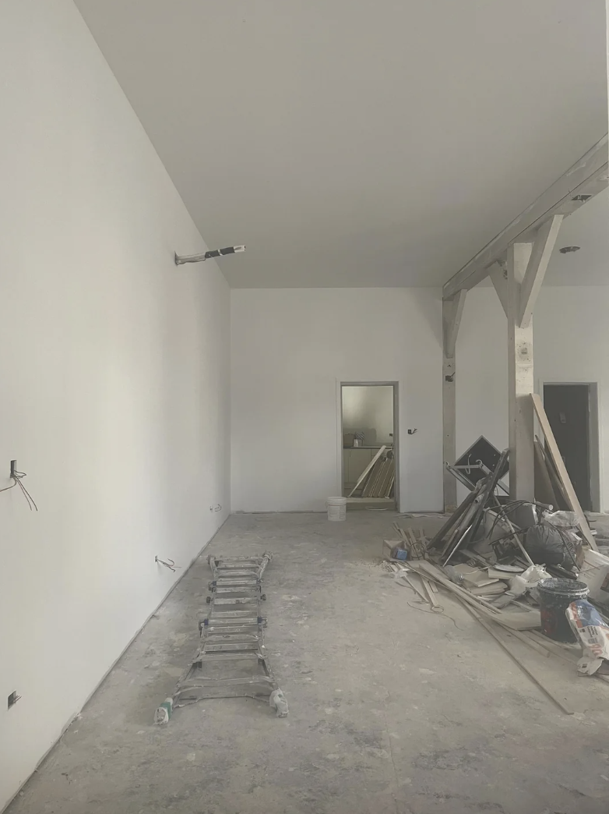
CONSTRUCTION LOAN PROPOSAL
Sharp Line Cuts McNichols Rd, Second Location
Prepared by James A. Gutierrez · January 2027
(313) 555-0217 · james.gutierrez@Greenridertech.co

Slide 2
Business Overview
Sharp Line Cuts , twelve years on Livernois Ave
12 years
In operation (since Feb 2014)
4 staff
James + Darius + Andre + Ty
$82k/yr
James net personal income
$22k
Second-location fund saved
Business Model
• Chair rental: Darius Webb and Andre Coleman each pay $275/week, totaling $28,600/year base income.
• James retains his own client revenue, currently ~$58,000/year in barbering services.
• Apprenticeship pipeline: Ty Jackson (17 months) targeting the McNichols chair at soft opening.
• Strong community presence on Livernois and Russell Woods corridors for twelve consecutive years.
• Target 1,200 sq ft at McNichols Rd , same chair-rental model, expanded capacity.

Slide 3
McNichols Corridor Opportunity
Underserved market one mile north of the Livernois flagship
+18%
Corridor foot traffic growth
18-55
Primary demographic age range
3
New barber stations planned
Mar 27
2027 soft opening target
Why McNichols Works
• Same neighborhood network , referrals already coming from the corridor.
• No direct comparable competition within a half-mile radius.
• Ty Jackson will be licensed and ready for a third rental chair at opening.
• Five-year lease term with two renewal options negotiated and signed.
• Build-out already in progress , framing and demo complete as of January 2027.

Slide 4
Build-Out Investment
Funding Plan
Working budget: ........... $45,000 to $55,000
Second-location fund: ..... $22,000 (Motor City Commerce Bank ****3592)
Construction loan request: $23,000 to $33,000
Option A fixtures: ........ $13,950 (saves $2,610 vs Option B)
Fund raised since: ........ 2022 at $500/month
Projected break-even: Month 4 of operations.
Projected Month-6 revenue: $8,500+/month.

Slide 5
Fixture Sourcing: Option A Selected
Based on cost comparison across ten fixture categories
Category Option A Option B
----------------------------------------------------------
Barber chairs (3-station) $5,000 $6,720
Reception seating (4-seat) $3,560 $4,200
Waiting area benches $840 $700
Retail shelving unit $780 $1,100
Work-station mirrors (3) $1,300 $1,440
Anti-fatigue floor mats $510 $660
Storage cabinets $1,160 $760
Ceiling lighting package $220 $300
Hot-lather station $340 $280
Breakroom/misc furnishings $240 $400
TOTAL $13,950 $16,560
→ Option A saves $2,610 over Option B. Option A selected.

Slide 6
Operating Model
Monthly Cost Structure
Commercial rent ......... $2,400
Utilities ............... $400
Supplies ................ $500
Business insurance ...... $250
Marketing ............... $200
Miscellaneous ........... $450
TOTAL MONTHLY COSTS ..... $4,200
Break-even: Month 4.
Month 6 target: $8,500/mo.
Revenue = chair rental + James barbering.

Slide 7
Build-Out Timeline
Oct 12, 2026
Lease walk-through with commercial realtor. Punch list delivered to contractor.
Oct 2026
Five-year lease signed. Two renewal options.
Nov 2026
Demolition and framing begin. Plumbing rough-in completed.
Jan 2027
Electrical rough-in. Fixture Order A placed with Premier Chair Co.
Feb 18, 2027
Contractor sign-off walk-through. Punch list closeout.
Mar 2027
Final inspections. Signage installed. Staff training at the Livernois shop.
Mar 27, 2027
Invite-only soft opening. Staff family, long-time clients, mentee alumni.

Slide 8
The Ask
Construction Loan Request
Amount: $25,000 to $33,000 (gap between fund and total budget)
Use: Build-out completion, fixtures, signage, first-month float
Repayment: Begin Month 3 from chair-rental base income
Security: Twelve-year operating history at 18247 Livernois Ave
Why James Gutierrez?
• Twelve years of unbroken operations , zero delinquencies on record.
• Proven chair-rental model: $28,600/year in fixed rental income regardless of James's own volume.
• Darius Webb (eight years, trusted) manages the Livernois floor during any transition.
• Ty Jackson licensed and ready for a revenue chair at McNichols opening , third income stream.
• Second-location fund ($22,000) demonstrates twelve months of disciplined forward planning.
$22k
Saved (fund)
Month 4
Break-even
Mar 27
2027 opening

